Slide 1

ECE 1710: Power Distribution Systems Engineering and Smart Grids
Lecture 2
Dr. Robert Kerestes
University of Pittsburgh
Swanson School of Engineering
Department of Electrical and Computer Engineering
Notes:
Instructions for editing school and department titles:
Select from menu: View > Master > Slide Master
Click on each text area you wish to edit. Text will become editable.

Slide 2
Outline
Outline of Lecture No. 2
Module #1:
Three-Phase Circuits
Module #2: Introduction to Distribution Systems
Module #3: Feeder Maps and Characteristics
Module #4: Load Definitions

Slide 3
Learning Objectives
Learning Objectives:
Perform calculations for rated three-phase circuits
Describe the circuitry in an electrical distribution system and identify distribution system components
State the importance of mapping in distribution systems and identify new and state of the art tools for this application
List the information needed for accurate distribution system modeling
Define important quantities for distribution system loads

Slide 4
Three-phase circuits

Slide 5
Three-phase circuits:
In almost all electric power generation and most of the power transmission in the world today, is in the form of three-phase ac circuits.
A three-phase ac power system consists of three-phase generators, transmission lines and loads. These ac power systems change voltage levels using three phase transformers.

Slide 6
Three-phase circuits:
Three-phase ac power systems have three advantages over single-phase ac power systems
It is possible to get more power per kilogram of metal from a three-phase machine (economically more efficient)
The power delivered to a three-phase load is constant at all times, instead of pulsing as it does in single-phase systems.
Three-phase systems also make the use of induction motors easier by allowing them to start without special auxiliary starting windings.

Slide 7
Three-phase circuits:
A three-phase generator consists of three single-phase generators, with voltages equal in magnitude but differing in phase angle from the others by 120˚.
Each of these three generators could be connected to one of three identical loads by a pair of wires, and the resulting power system would be as shown on the next series of slides.

Slide 8
Three-phase circuits:
A balanced three-phase system consists of:
Balanced three-phase generation source
Balanced three-phase loads i.e. impedance per phase is exactly equal
Balanced three-phase load voltages and currents

Slide 9
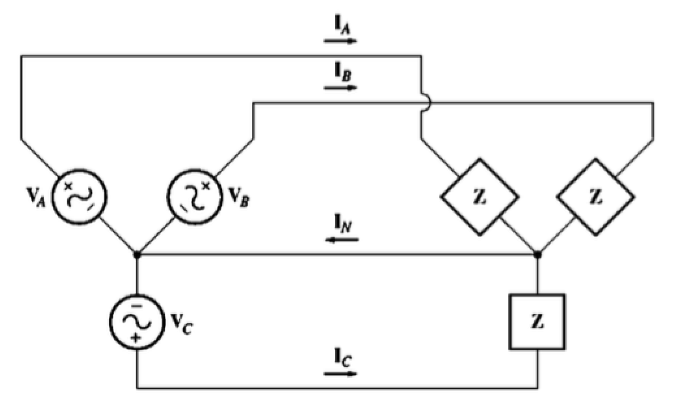
Three-phase circuits:
The three-circuits connected together with a common neutral (aka wye-connected)

Slide 10
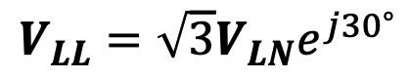

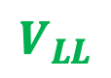
Three-phase circuits:
For wye-connected circuits there are line-to-line and line-to-neutral voltages. These are related by
$$V_{LL}=\sqrt{3}V_{LN}e^{j{30}^{∘}}$$
Phasors
$$V_{LL}$$
$$V_{LN}$$

Slide 11
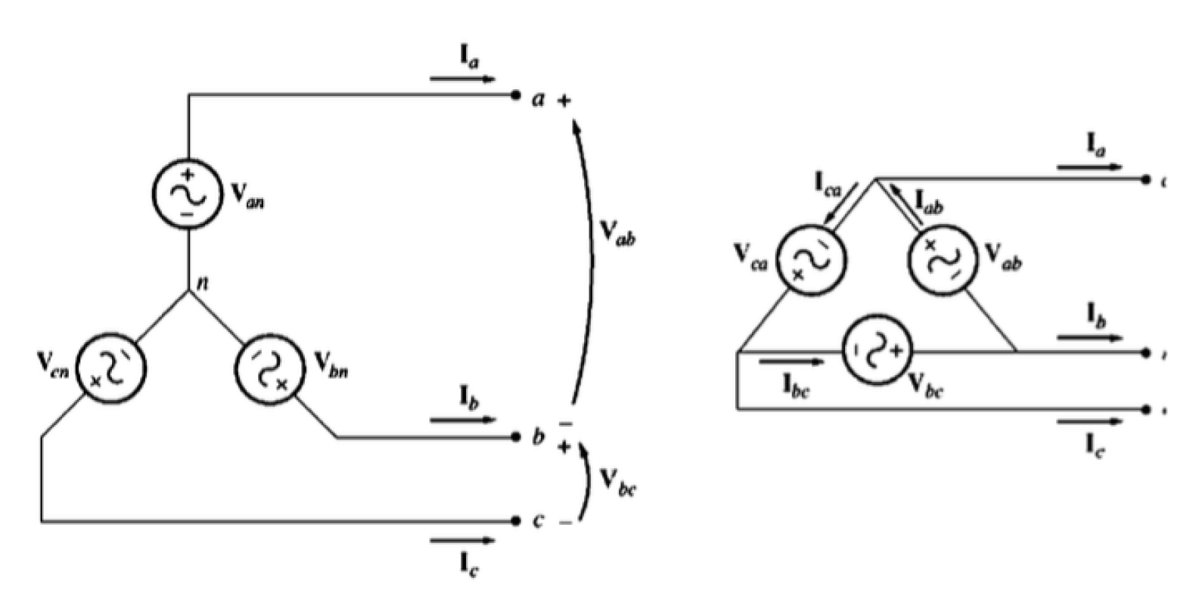
Three-phase circuits:

Slide 12
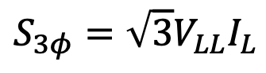
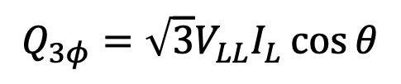
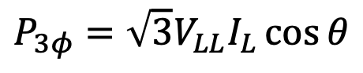
Three-phase circuits:
Power calculations in balanced three-phase circuits
$$S_{3φ}=\sqrt{3}V_{LL}I_{L}$$
$$P_{3φ}=\sqrt{3}V_{LL}I_{L}\cos{θ}$$
$$Q_{3φ}=\sqrt{3}V_{LL}I_{L}\cos{θ}$$

Slide 13
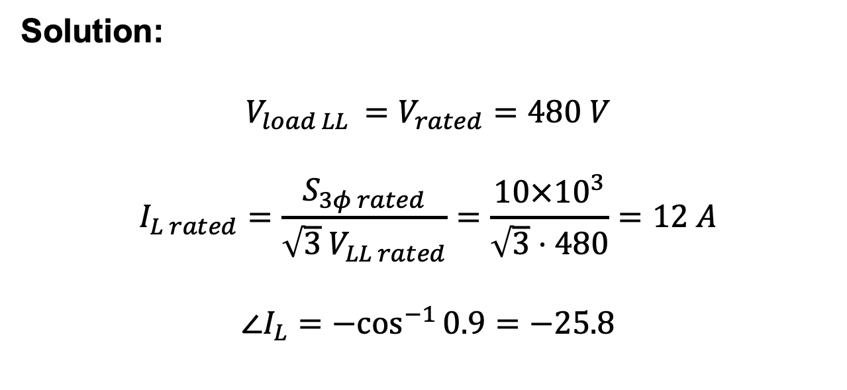
Three-phase circuits:
A three-phase delta connected 10 kVA, 480 V, 0.9 pf lagging, load is fed from a generator through a 1 ohm transmission line. If this load is operating at rated conditions, find the line-to-line and line-to-neutral voltages of the generator.
Solution:
$$V_{load LL }=V_{rated}=480 V$$
$$I_{L rated}=\frac{S_{3φ rated}}{{\sqrt{3} V}_{LL rated}}=\frac{10×{10}^{3}}{\sqrt{3}⋅480}=12 A$$
$$∠I_{L}={−cos}^{−1}{0.9}=−25.8$$

Slide 14
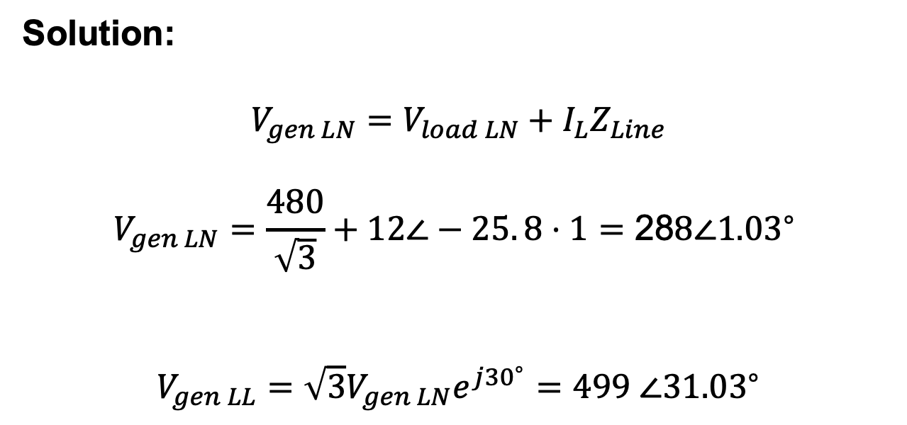
Three-phase circuits:
Solution:
$$V_{gen LN}=V_{load LN}+I_{L}Z_{Line}$$
$$V_{gen LN}=\frac{480}{\sqrt{3}}+12∠−25. 8⋅1=\text{28}8∠{1.03}^{∘}$$
$$V_{gen LL}=\sqrt{3}V_{gen LN}e^{j{30}^{∘}}=499 ∠{31.03}^{∘}$$

Slide 15
Introduction to Distribution Systems

Slide 16
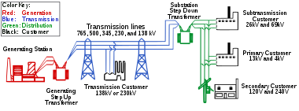
Introduction to Distribution Systems
Electric power systems have three major components
Generation (centralized)
Transmission
Distribution
Simplified diagram of ac electricity distribution from generation stations to consumers

Slide 17
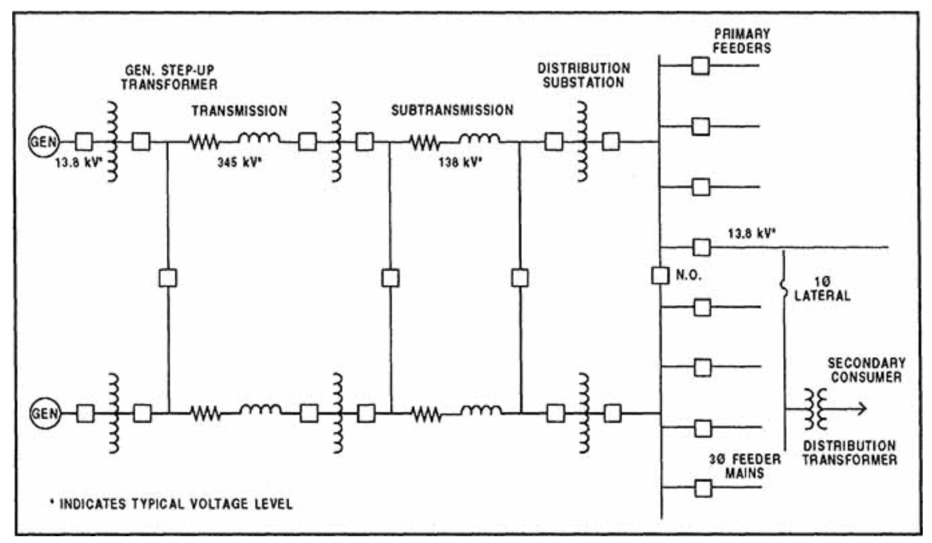
Introduction to Distribution Systems
Typical Electric Supply System

Slide 18
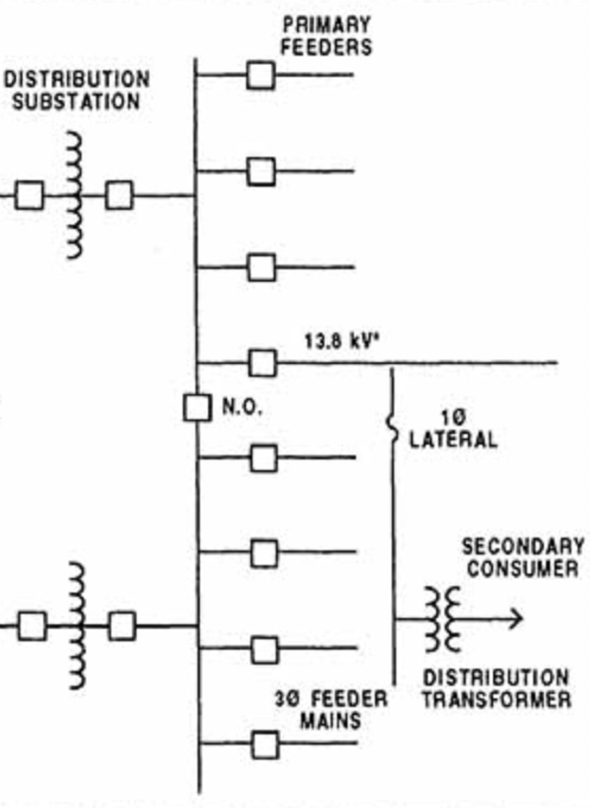
Introduction to Distribution Systems
The distribution system, which is our main area of interest, is commonly broken down into the following three components:
Distribution substation
Distribution primary
Secondary

Slide 19
Introduction to Distribution Systems
The distribution system is fed through distribution substations. These substations consist of an almost infinite number of designs based on considerations such as
Load density
High side voltage
Low side voltage
Land availability
Reliability requirements
Load growth
Voltage drop
Emergency conditions
Cost and losses
Renewable penetration

Slide 20
Introduction to Distribution Systems
Distribution Substations

Slide 21
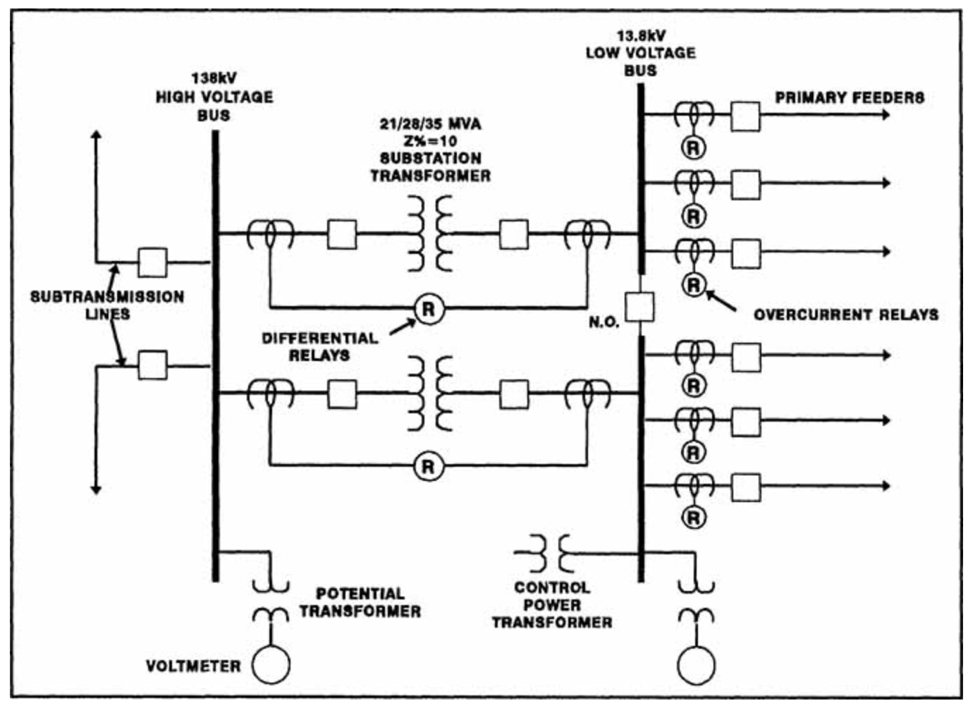
Introduction to Distribution Systems

Slide 22

Introduction to Distribution Systems
https://www.opdc.org/design-development-review-projects/2019/10/9/duquesne-light-substation

Slide 23

Introduction to Distribution Systems
https://www.duquesnelight.com/service-reliability/infrastructure-projects/riazzi-substation#undefined

Slide 24
Introduction to Distribution Systems
Distribution feeder circuits are the connections between the output terminals of a distribution substation and the input terminals of primary circuits. The distribution feeder circuit conductors leave the substation from a circuit breaker or circuit recloser via underground cables, called substation exit cables.
3-phase distribution feeder bay
Distribution main feeder

Slide 25
Introduction to Distribution Systems
Radial distribution feeders are characterized by the presence of only one path for power to flow from the source (i.e. the distribution substation”) to each customer.
A typical distribution system consists of one or more distribution substations consisting of one or more “feeders.” Components of the feeder may consist of the following:
Three-phase primary “main” feeder
Three-phase, two-phase (“V” phase), and single-phase laterals
Step-type voltage regulators
In-line transformers
Shunt capacitor banks
Distribution transformers
Secondaries
Three-phase, two-phase, and single-phase loads

Slide 26
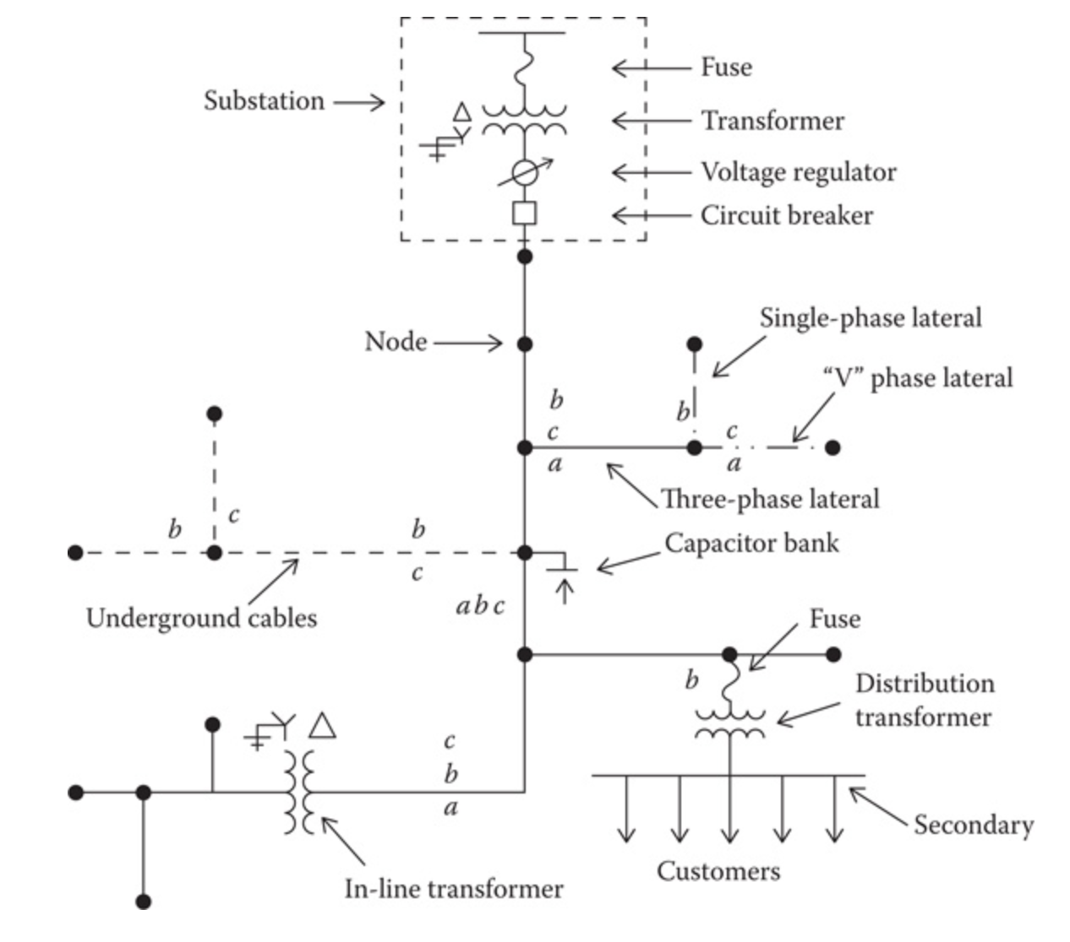
Introduction to Distribution Systems
Simple distribution feeder

Slide 27
Introduction to Distribution Systems
Considerations for distribution feeder circuits:
Feeder loading is inherently unbalanced, this makes analysis of these systems much different than balanced transmission level systems e.g.
Power flow studies
Short circuit studies
Modeling must be very accurate, and all phases must be considered individually using “phase frame” rather than symmetrical components

Slide 28
Feeder Maps and Characteristics

Slide 29
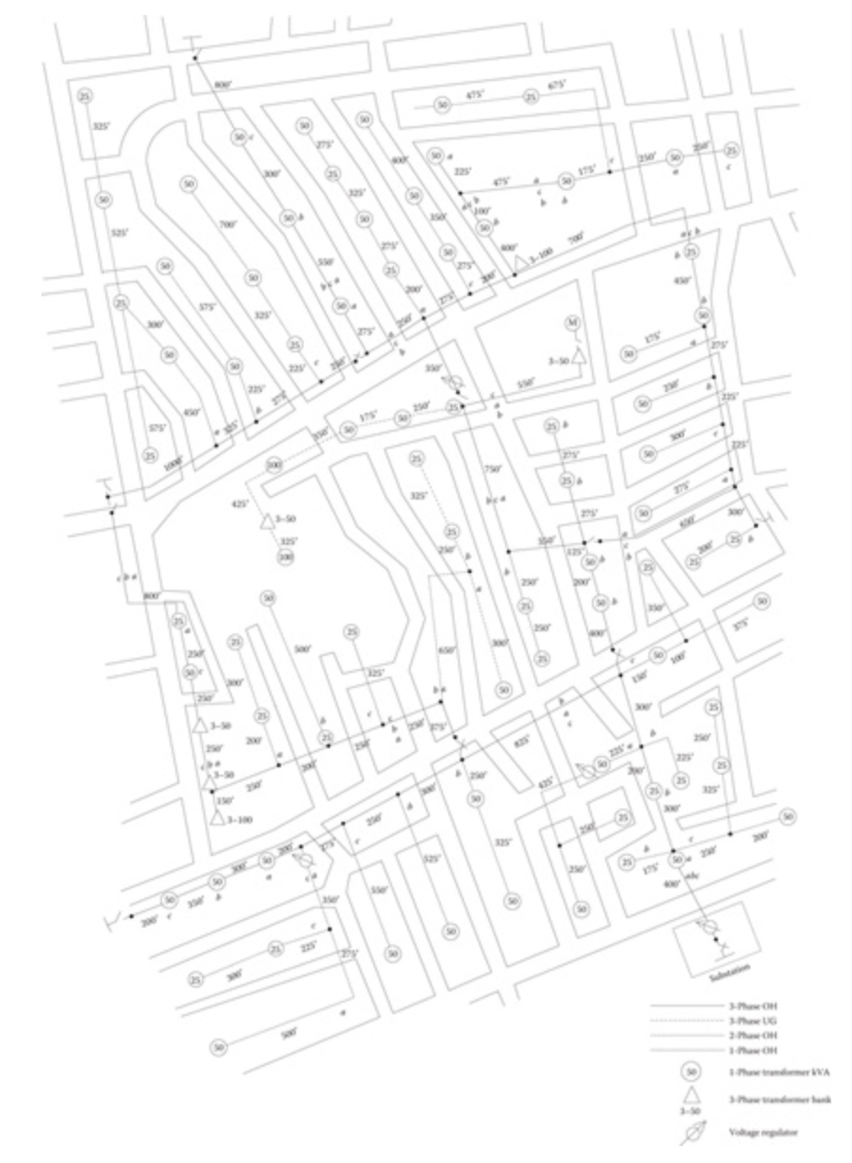
Feeder Maps and Characteristics
Feeder maps give a detailed description of where the circuitry is but also the geographical and traffic layout, why might this be important?

Slide 30
Feeder Maps and Characteristics
Information that a distribution engineer would need to know about a feeder circuit:
Lines (overhead and underground)
Where
Distances
Details
Conductor sizes
Phasing

Slide 31
Feeder Maps and Characteristics
Information that a distribution engineer would need to know about a feeder circuit:
Distribution transformers
Location
kVA rating
Phase connection

Slide 32
Feeder Maps and Characteristics
Information that a distribution engineer would need to know about a feeder circuit:
In-line transformers
Location
kVA rating
Connection

Slide 33
Feeder Maps and Characteristics
Information that a distribution engineer would need to know about a feeder circuit:
Shunt capacitors
Location
kvar rating
Phase connection

Slide 34
Feeder Maps and Characteristics
Information that a distribution engineer would need to know about a feeder circuit:
Voltage regulators
Location
Phase connection
Type
Single-phase
Three-phase

Slide 35
Feeder Maps and Characteristics
Information that a distribution engineer would need to know about a feeder circuit:
Switches
Location
Normal open/close status

Slide 36



Feeder Maps and Characteristics
Geographical Information Systems (GIS) are now quite common for distribution engineering. These systems use actual maps to plot useful data which has some geospatial relevance to it.

Slide 37
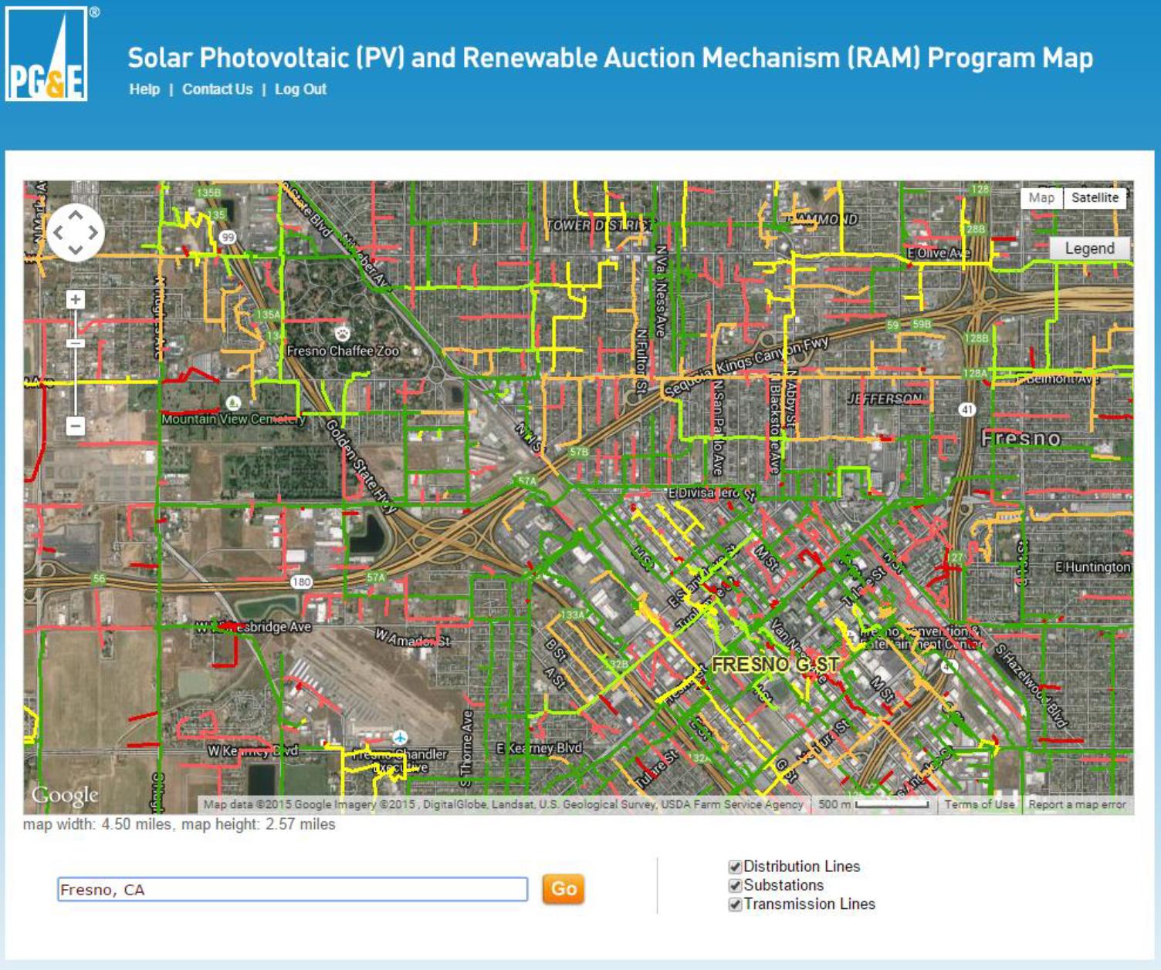
Feeder Maps and Characteristics

Slide 38
Feeder Maps and Characteristics
Electrical characteristics for each device will have to be determined before the analysis of the feeder can commence. In order to determine the electrical characteristics, the following data must be available:
Overhead and underground line spacings
Conductor tables
Geometric mean radius (GMR) (ft)
Diameter (in.)
Resistance (Ω/mile)

Slide 39
Feeder Maps and Characteristics
Voltage regulators
Potential transformer ratios
Current transformer ratios
Compensator settings
Voltage level
Bandwidth
R and X settings in volts
Transformers
kVA rating
Voltage ratings
Impedance (R and X)
No-load power loss

Slide 40
Load definitions

Slide 41
Load definitions
The load for a distribution systems is constantly changing. For example when a dryer turns on or off, that completely changes the load. In order to describe the changing load, we need to define certain terms.

Slide 42
Demand
Load averaged over a specific period of time
Load can be kW, kvar, kVA, or A
Must in include the time interval
Example: The 15 min kW demand is 100 kW.

Slide 43
Maximum demand
Greatest of all demands that occur during a specific time
Must include the demand interval, period and units
Example: The 15 min maximum kW demand for the week was 150 kW.

Slide 44
Average demand
The average of the demands over a specified period (day, week month, etc.)
Must include demand interval, period and units
Example: The 15 min maximum kW demand for the week was 150 kW.

Slide 45
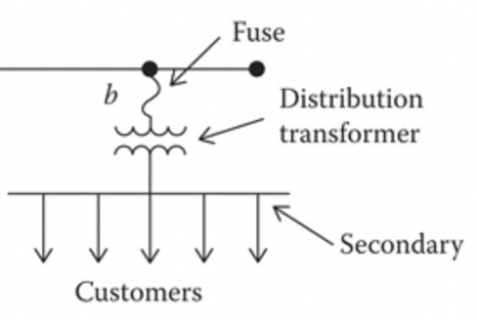
Diversified demand
Sum of demands imposed by a group of loads over a particular period.
Must include demand interval, period, and units
Example: The 15 min diversified kW demand in the period ending at 9:30 was 200 kW

Slide 46
Maximum diversified demand
Maximum of the sum of the demands imposed by a group of loads over a particular period
Must include demand interval, period, and units
Example: The 15 min maximum diversified kW demand for the week was 500 kW

Slide 47
Maximum noncoincident demand
For a group of loads, the sum of the individual maximum demands without any restriction that they occur at the same time.
Must include demand interval, period, and units
Example: The maximum noncoincident 15 min kW demand for the week was 700 kW

Slide 48
Demand factor
Ratio of maximum demand to connected load

Slide 49
Utilization factor
Ratio of maximum demand to related capacity

Slide 50
Load factor
Ratio of the average demand of any individual customer or a group of customers over a period to the maximum demand over the same period.

Slide 51
Diversity factor
Ratio of the "maximum noncoincident demand" to the "maximum diversified demand“

Slide 52
Load diversity
Difference between the "maximum noncoincident demand" to the "maximum diversified demand"

Slide 53
Time | Load 1 (kW) | Load 2 (kW) | Load 3 (kW)
10:00 | 2 | 1 | 1
10:15 | 1 | 3 | 2
10:30 | 1 | 2 | 2
10:45 | 1 | 1 | 5
Example: For the group of loads above
What is the maximum diversified demand?
What is the max noncoincident demand?
What is the diversity factor? (round to one decimal place)

Slide 54
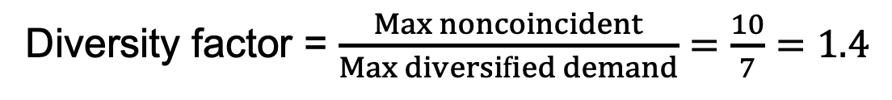
Time | Load 1 (kW) | Load 2 (kW) | Load 3 (kW) | Diversified Demand
10:00 | 2 | 1 | 1 | 4
10:15 | 1 | 3 | 2 | 6
10:30 | 1 | 2 | 2 | 5
10:45 | 1 | 1 | 5 | 7
Max diversified demand = 7 kW at 10:45
Max noncoincident demand = 2 + 3 + 5 =10 kW
Diversity factor = $\frac{Max noncoincident}{Max diversified demand}=\frac{10}{7}=1.4$

